Slide 1
Reference Architecture
Prepared By: Specialty Architecture Group
Oct 5th , 2017

Slide 2
Reference Architecture
A reference architecture describes how technical capabilities are organized to achieve a particular purpose. It is a blueprint of the to-be state with well defined scope, requirements, architectural decisions, patterns and guidelines using a standard vocabulary.
WHAT IS ….
A reference architecture ensures high quality project results by delivering best practices, guidelines and patterns in a standardized, methodical way. It also accelerates the creation of an implementation architecture by allowing the emulation of a proven approach.
VALUE

Slide 3
Design Principles
Discover the core domain before you start a Project
Create a Model to solve Domain problems
Using a ubiquitous language to Enable Modeling Collaboration
Isolate Models from Ambiguity and Corruption
Understand the relationship between context.

Slide 4
Design Approach

Slide 5
Architecture Principles
Domain Driven Design / Model Driven Design
Culture of Automation Build, test & release
Promote Polyglot, Decentralization and Separation of Concerns
Deploy Independently
Failure Isolation
Highly Observable Health of single service and health of whole eco-system
Resilience : Scaling

Slide 6
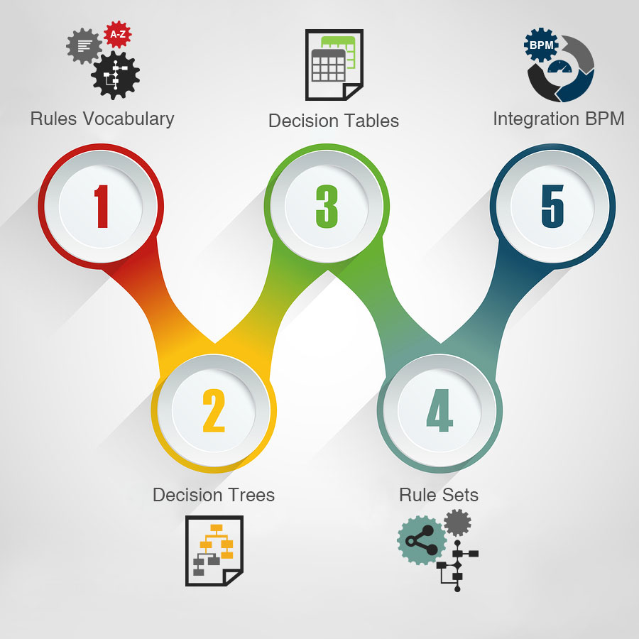
Specialty Reference Architecture
Channels
Services
Enterprise
Systems
Contact
Center
Service Discovery
Service Observability
Service Fault Tolerance
Web App
Package
Legacy
External
Self-Service
Workplace
Process Services
Visibility Services
Patient
Drug
Retail Specialty
Pharmacy
API
GATEWAY
API Management
Billing
Supplies
Mobile
Identify
Management
Provider
Claims
Nurse
Workplace
Optimization Services
Analytics
Information Services
Partner
Workplace
Service Registry
Sparcs
HBS Data
SPRx
Electronic Business
Gateway
Message Queue
Rules Engine
Batch Service
Q1
Message Listener
Q2
Vendor / Partner
Systems

Slide 7
Capability View
Systems
of Engagement
Edge Proxy
Services
Data
As a Service
Systems of
Automation
Web App
Development
Systems of
Record
Portals
Analytics
API Gateway
SDK
API Store
Filters
API Analytics
ALM
Web Services
Web API’s
Service
Registry/Discovery
Message
Persistence
Workflow
Services
Rules
PaaS
Data Services
Cache
Connectors/
Adapters
Taxonomy
Data Analytics
RDBMS
NoSQL
File Repository
SaaS
SPARX / HBS
Enterprise
Monitoring
Legend
Evaluated
Yet to Evaluate

Slide 8
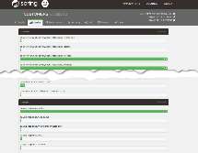
Logical View Application
Consumer Applications / Portals / Mobil Apps
(Zuul) Edge Proxy Service
Legend
Application Container
Virtual Machine
Spring Boot
Bounded Context Web API
Bounded Context Web API
Bounded Context Web API
Virtual Machine
Application Server
Undertow
Kibana – Service Monitoring
Service Discovery - Consul
Spring Boot
Spring Boot
Log Management – ELK Stack
Virtual Machine
Virtual Machine
Consul – Service Discovery

Slide 9
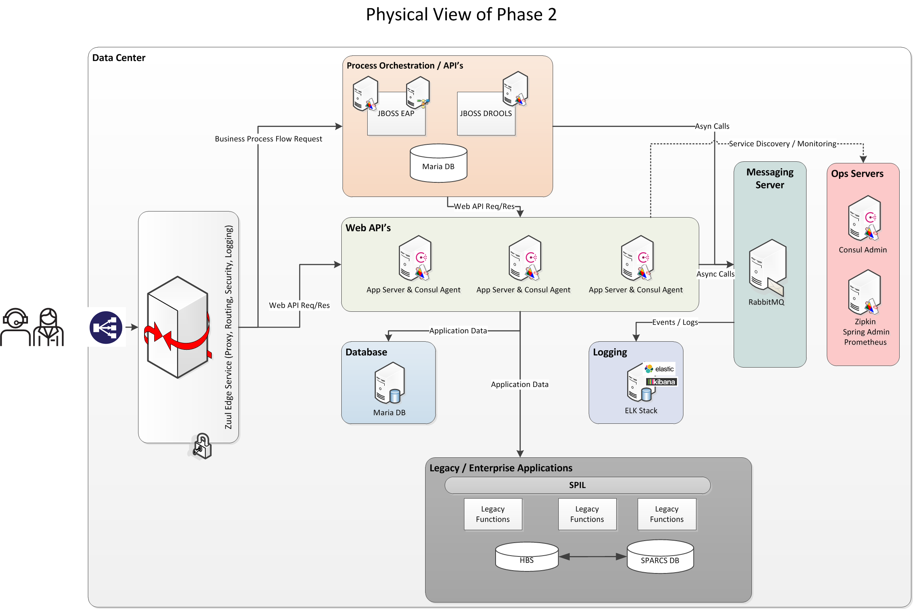
Physical View

Slide 10
Adopted 12 Factor
Codebase
One codebase per service, tracked in revision control many deploys (GIT)
Dependencies
Explicitly declare and isolate dependencies ( Nexus )
Config
Store configuration in the environment ( Git )
Build/Release/Run
Strictly separate build and run stages
Processes
Each Web Service is a stateless process.
Data Isolation
Each Service will maintain its bounded context data
Concurrency
Scale Business Services independently either by horizontal or vertical
Disposability
Instances of the Web service will be disposable
Logs
ELK / Spring Actuator for Logging and metrics

Slide 11
Bricks
Brick and Mortar Model

Slide 12
Proxy Model
As systems become distributed, and as service instance lifecycles become more dynamic and independent, location of and communication with dependencies becomes more challenging.
Systems often must support multiple user experience options
UI layer can require exposing the architecture to the public network.
API needs for a device are often quite different from a web UI.
Performance Optimization
Dynamic Service Discovery
Load Balancing
High Availability
Application Management
Security (SSL/TLS)
Health Checks
Throttling

Slide 13
Service Discovery
Server-Side Discovery - The client makes a request to a service via a load balancer. The load balancer queries the service registry and routes each request to an available service instance
Routes, Security
Load Balancing
Edge Proxy Service
Ribbon
Client
Rest API
Discover
Service
Service
Location
Service A
Publish
Consul
Rest API
Address, Ports,
Health Checks,
Metadata
Service B
Client-Side Discovery - Client is responsible for determining the network locations of available service instances and load balancing requests across them.
Edge Proxy Service (Zuul)
Client
Rest API
Discover
Service
Service
Location
Service A
Publish
Eureka Registry
Rest API
Service B

Slide 14
Logical View Application – Service Communication
ONE-TO-ONE | ONE-TO-MANY
Request/Response
Notifications Request / Async Response | Publish / Subscribe Publish / Async Responses
SYNCHRONOUS
ASYNCHRONOUS
One-to-one
App
REQUEST/RESPONSE
Service A
One-to-many
App
REQUEST/RESPONSE
REQUEST
PUB/SUB
Service A
Service B
Destination

Slide 15
Logical View Application – Inter Process Communication
Services can use synchronous request/response-based communication mechanisms such as HTTP-based REST or gRPC. Alternatively, they can use asynchronous, message-based communication mechanisms such as AMQP .
REST
App
REST
REST
POST
GET
201 CREATED
200 OK
Service A
Service B
Destination
RPC
REST
RPC
App
REQUEST/RESPONSE
REQUEST
PUB/SUB
Service A
Service A
Destination

Slide 16

Config Server – Runtime Externalized Reconfiguration
Push Configuration Properties
GitLab
[CVS Labs]
Configuration Server
REST API for Configuration
Properties
Spring Boot
SRE
Virtual Machine
---------------------------------------------------------------------------------------------------------------------------------------
Webhook
HTTP Post
Push Configuration Properties
GitLab
[CVS Labs]
Configuration Server
REST API for Configuration
Properties
SRE
Pull Conf Properties
Pull Conf on Refresh Event
Messaging Middleware
Providing Pub/Sub for
Refresh events
Spring Boot
Virtual Machine

Slide 17
Security view
Application Security

Slide 18
Security View

Slide 19
Security Architecture
All Specialty systems will authenticate/authorize using the JWT which is obtained by the Security service. The communication of JWT will be securely transported
1-way and 2-way TLS over HTTP will be used as the secure transport protocol for communication. The CA will be internal CA used to sign certificates.
The inter-service communication will work using mutual authentication (2-way TLS).
Gateway and Service Discovery components will work over 2-way TLS as well.
Non-Specialty systems will interact with their own certificates using mutual authentication (2-way TLS)

Slide 20
CI / CD
Quality Assurance & Automation

Slide 21
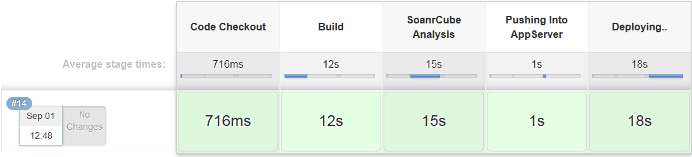
Continuous Integration & Deployment

Slide 22
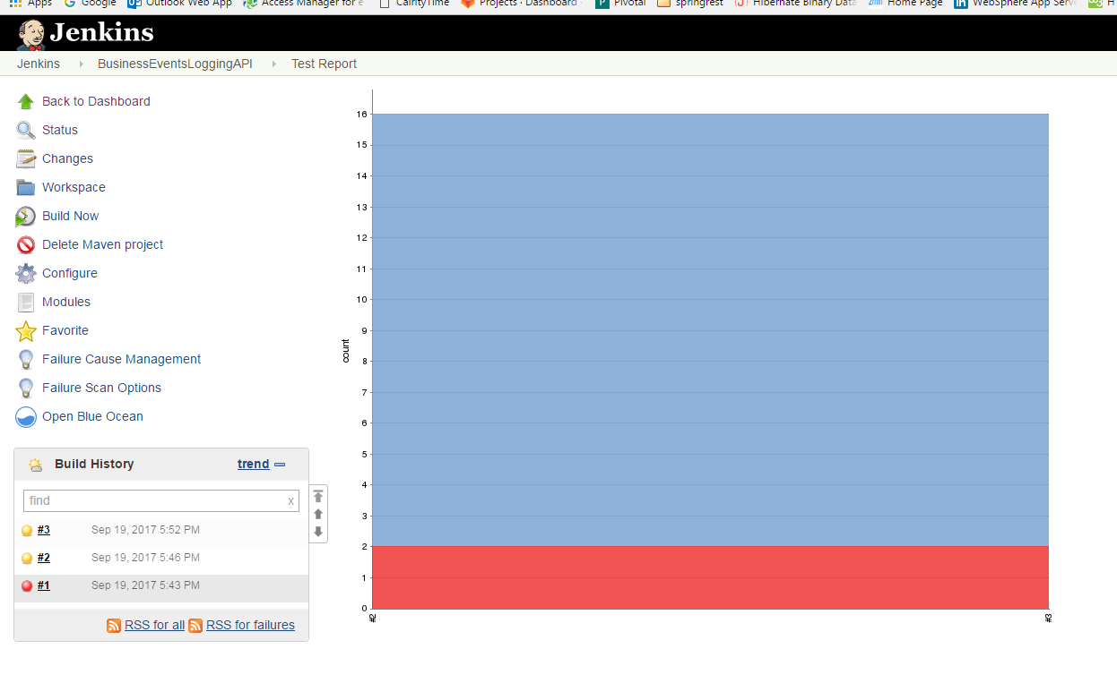
Test Report
14 Passed
jUnit graph
Integrated with Jenkins via plugin
The graph represents out of 16 test cases.
2 Failed

Slide 23
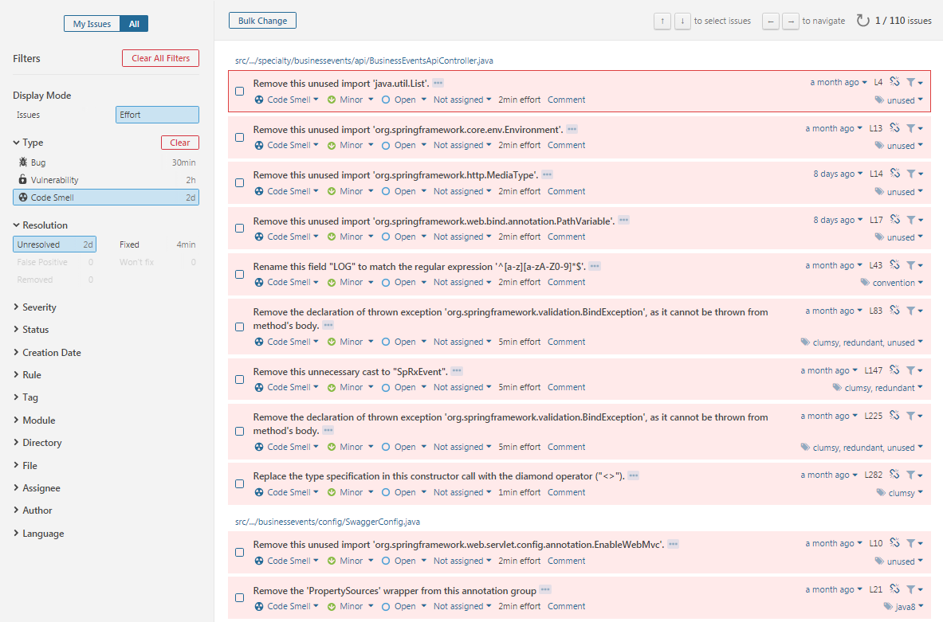
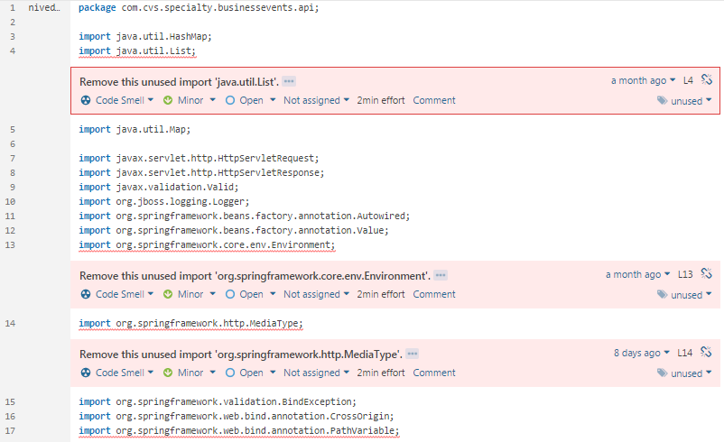
SonarQube-Code Analysis

Slide 24
Integration telemetry
Fault Tolerant

Slide 25
Service Failure
Edge Service implement circuit breakers, which means that after a specific threshold, the Edge Service will stop sending data to the component that’s failing. Circuit breakers simply close the circuit so no more requests are allowed to go to that component
LB
Service A
DB Schema
Client
Edge Service
LB
Service B
DB Schema
LB
Service C
DB Schema

Slide 26
Circuit Breaker
Gather Metrics
Circuit Breaker
[Component]
Publish Metrics
Gather Metrics
Circuit Breaker
Metrics Aggregator
[Container]
Aggregates metrics published
By all circuit breakers
In the system
PublishMetrics
Circuit Breaker
Metrics Dashboard
[Container]
Provides a unified dashboard
of all Circuit Breaker metrics.
Circuit Breaker
[Component]
PublishMetrics
Gather Metrics
Circuit Breaker
[Component]
PublishMetrics

Slide 27
Logging

Slide 28
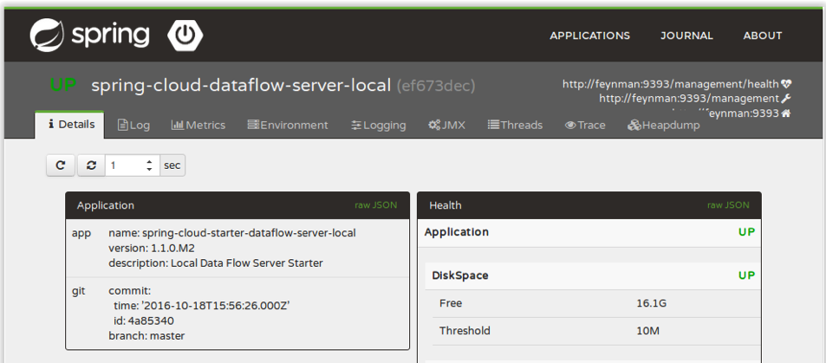
Monitoring
Monitor containers (VM’s) and what’s inside them.
Alert on service performance.
Monitor services that are elastic and multi-location.
Monitor APIs.
Map monitoring to your organizational capabilities.

Slide 29
Solution
Applying Mortar

Slide 30
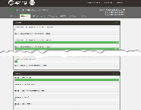
Logical View BEL Pilot
Consumer Applications / Portals / Mobil Apps
Data Center
Edge Proxy Service
(Zuul Reverse Proxy, Ribbon Load Balance, Filters [Security, Locking, Logging])
Consul – Administration
Administration (Metrics, Health, Endpoint Info, Trace)
Business Event Logging
Business Event Logging
Spring Boot
Virtual Machine
Virtual Machine
Virtual Machine
Message Bus (RabbitMQ)
MariaDB
Kibana – Service Monitoring

Slide 31
Pilot after Applying Patterns
Filters [Security/Locking]
(Oracle)
Consul
(Service Discovery)
Config Server
(External Config)
Zipkin
(Distributed Tracing)
Spring Admin / Prometheus
Metrics
Search Events
(VM : Kibana)
Data Visualization
Search Events by various Attributes
Authenticates & Authorize
Edge Gateway
(VM : Spring Boot App)
Serves up the REST API
For BEL
Message Broker
(VM : RabbitMQ)
PubSub Messaging for
Events
Elastic Search
(VM : ELK Stack)
Immutable Data Store
Web App
HTML, Angular JS, CSS
Uses API
Send Events
Users
Business API
BEL Service
(VM : Spring Boot App)
Capture Events
BEL Data Service
(VM : Spring Boot App)
Direct CRUD Operations
Service
Database
(VM : MariaDB)
Database for Business
Events
Data
API
Stores & Retrieves Data

Slide 32
Codebase Management
Option I
Master-Branch - Stable branch.
Dev-Branch - Clone of Master
Working branch; Developer check-out code from this branch
Once developer commits the code, perform Merge-Request (pull request) to merge code into Dev-branch.
After being approved, the codes get merged in Dev-branch and is ready to be merged into Master-Branch for Production.

Slide 33
Codebase Management
Option II
This approach involves working with Master-branch.
This is simple and works well for small projects or solving issues
-The cons are this prone to mistakes as developers come with varying level of expertise.

Slide 34
Deployment
Deployment View

Slide 35
Deployment View
Multiple Service Instances Per Host Pattern :
One variant is for each service instance to be a process or a process group
Other multiple service instances in the same process or process group
VIRTUAL MACHINE
Service A
Service B
Service C
Service Instance per Virtual Machine Pattern :
Services can each live in their own virtual machine.
Service A
DEPLOYED AS
PACKAGED AS
VIRTUAL MACHINE
Service B
Service
Service C

Slide 36
Thank You!

